Slide 1
Reliant Mobile Sync w/Leadership
Team Update
9/12/2024
Notes:
This Streamlined Leadership Sync meeting is intended to focus on the impediments the team has overcome or currently faces from the perspective of:
The Product Owner
The Dev Lead (representing the developers of course)
The Scrum Master
Definition
Impediment –
Anything that hinders/slows/prevents/blocks/makes more challenging/cumbersome the execution of team activities or processes or the team’s ability/capacity to deliver value – this includes but is not limited to work interruptions, overloaded/shared services or team members, equipment/devices, environments, processes, etc. - and the team has not been able or does not have the influence/authority to alleviate/remove the impediment on its own
Each will speak to the top 2-3 challenges/impediments their team faces with the appropriate level of detail to ensure leadership has a clear picture of the issue and understands the ASK from the team to alleviate/remove the challenge/impediment
NOTE- It is OK to include Impediments the team has solved or overcome this year – but that should not be the focus of the conversation

Slide 2
2024 Team Roster

Slide 3
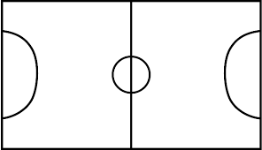
Reliant Mobile App Team Roster
Shevon Patel
Mobile IT Man.
Kevin Rios
System Architect
Ravi Penduriti
Mobile Project Lead
Reliant Mobile Leaders, previously team of 4 that defends against impediments and turns the defensive stops to offensive opportunities.
9 core developers and QA members, who drive implementation of value adding features.
Achappan Mahalingham
Android
Indiran Manivannan
Android
TBD Dev Lead
Bala Sangana
iOS
Lakshminarayanan S.
Quality Assurance
Anthony Wilson
Scrum Master
Gary Gokhman Product Owner
Jeanette Martinez
QA Lead
Sai Pallagani
iOS
Raghavendra Kamath
Quality Assurance
Deep Jakkam
iOS / Android
Alex Otero
AEM
Raja Somu
API

Slide 4
Team Impediments

Slide 5
Product Owner Perspective – Impediments
Impediment | Impact to the Team | Attempted Solutions | ASK from Leadership
Production environment improvements Performance (journey and pages response times) Reliability (individual API/services, and infrastructure uptime) | Slowness and outages disrupt team productivity and impacts customer NPS / AMU | Non-commodity service improvements | A separate cross-functional team to identify specific improvements needed Proactive monitoring
Stage environment test scenario availability Test accounts get wiped out every year with the Stage refresh, which takes many weeks to get back to normal. Multiple team/people involved is setting up test accounts and specific scenarios Stage environment does not accommodate all features (e.g. Enphase – can only test in Prod) | Delays dev and testing Affects productivity and delivery | Attempt to preset the accounts before UAT starts | Need to automate the test scenario creation
Marketing Lack of priorities alignment Lack of visibility into backlogs and task assignment between Agile and Marketing teams (ADO vs Workfront) Need to confirm who owns AEM content/images updates. It should be Marketing, in my opinion. | Causes rework Delays delivery | Several meetings with Marketing to discuss lessons learned | Move to one work management tool (ADO) Should GTM help align Marketing priorities to Digital?
Need more Prod accounts for testing and troubleshooting purposes | We have found that there are scenarios that cannot be easily recreated in lower | Production support process to request access to specific accounts in prod | Provide incentives to employees to become “friendlies” across brands – e.g. 40% energy discount, free non-commodity products Easier/streamlined process to request shadow access ContentSquare in progress
Notes:
Intent – As a Product Owner – what are the top 3 impediments you face
WHAT is the Impediment
WHAT’s the Impact to the Team (why is this an Impediment)
What has the PO & Team tried to address the Impediment
What is the ASK from Leadership (if any) to help resolve the Impediment

Slide 6
Dev/QA Lead Perspective – Impediments
Impediment | Impact to the Team | Attempted Solutions | ASK from Leadership
Test data creation and management | Delays or blocks development and testing | Requested access for all QA to RPM test data report and SAP RPM and CMQ | No Ask, raising for visibility.
Automation runs interrupted | Test cases are skipped or interrupted in nightly run | Stagger scheduled team's jobs | No Ask, raising for visibility.
Manually Releasing iOS Test Build | Does not allow the Developers to quickly respond to bugs – delays product delivery | Kevin Rios is working to change the build process to ADO rather than App Center | No Ask, raising for visibility.
Notes:
Intent – As a Dev Lead – what are the top 3 impediments your team faces
REMEMBER – The Dev Lead is speaking for all Developers on the team regardless of area of focus
WHAT is the Impediment
WHAT’s the Impact to the Team (why is this an Impediment)
What has the Team tried to address the Impediment
What is the ASK from Leadership (if any) to help resolve the Impediment

Slide 7
Scrum Master Perspective – Impediments
Impediment | State | Impact to the Team | Attempted Solutions | ASK from Leadership
Consistency of MVP Mindset | In Progress | Extended time between deliveries (consistently more than 8 weeks between Feature releases) Team fatigue (result of implementing large features with aggressive delivery timelines) | Team session for being MVP minded (encouraging team to push for MVP deliveries) | Support MVP Feature delivery Help address fear from UX & Marketing
Frequency of Stakeholder Touchpoints / Timely feedback (Product Demonstration) | In Progress | High rate of defects/opportunity discovered late. Extended time between deliveries | Team discussions for bi-weekly review (ensure iOS and Android alignment and early dev feedback). | No ask from Leadership Raising for Awareness
Undefined Marketing Work Agreement | In Progress | Development Rework. Team receiving design after Feature development initiated | Marketing Working Agreement session facilitated (outcome Marketing & UX collaborate after creative review & Improved Marketing Communication) | No ask from Leadership Raising for Awareness
Notes:
Opportunity for Analytics MVP (32% of work items on average – per Release)
Intent – As a Scrum Master what are the top 3 impediments to agile growth and team maturity have you observed in your team
REMEMBER – Anti-patterns ARE Impediments
WHAT is the Impediment
Impediment State (DONE – DOING – NEXT)
WHAT’s the Impact to the Team (why is this am Impediment)
What has been tried (experiments) with the Team to address the Impediment
What is the ASK from Leadership (if any) to help resolve the Impediment
DONE – Top 2-3 impediments the team has successfully overcome – very short, bullet points, avoid spending a lot of time on the past
DOING – Top 2-3 impediments the team faces currently – spend most of your talk time here, still using bullet point approach
NEXT – Top 1-2 impediments you see on the horizon for the team – again, short, bullet points, avoid spending a lot of time on future items that are less clear/defined/certain

Slide 8
Top 3 Impediments Recap
Impediment 1:
Stage Environment Test Scenario/Data Availability
Current Status:
In Progress
Ask From Leadership?
Team is in progress of getting access to RPM Report & SAP. Additionally, the team would like to explore opportunities to automate data creation
Impediment 2:
Manually Releasing iOS Builds
Current Status:
In Progress
Ask From Leadership?
No Ask (reported for visibility). Kevin Rios owns converting the build process to Azure
Impediment 3: Consistency of MVP Mindset
Current Status:
In Progress
Ask From Leadership?
Help Address fears from Marketing & UX team

Slide 9
2024 Goals & App Rating

Slide 10

2024 Goals
Mobile App
23,500 incremental MAU
Goal: 453,117 | YTD Avg: 495,131 | 109% to goal
1,900 incremental Loyalty Sign-ups
Goal: 19,800 | YTD: 12,800 | 65% to goal
5,500 incremental Cross-sell offers
Goal: 6,013 | YTD: 6,143 | 102% to goal

Slide 11






TX Digital App Ratings vs Competitors
Ratings As of 7/3
2.7
Out of 5 | Apple
879 reviews
2.2
Out of 5 | Android
1.95k reviews
1.9
Out of 5 | Apple
65 reviews
2.3
Out of 5 | Android
106 reviews
4.9
Out of 5 | Apple
12.9k reviews
4.7
Out of 5 | Android
6.79k reviews
4.6
Out of 5 | Apple
5.5k reviews
4.5
Out of 5 | Android
1.4k reviews
Vs.
3.8
Out of 5 | Apple
13 reviews
3.1
Out of 5 | Android
8 reviews
1.5
Out of 5 | Apple
237 reviews
2.6
Out of 5 | Android
805 reviews

Slide 12
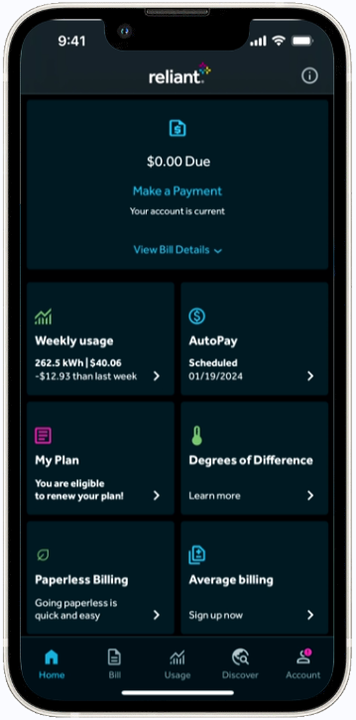
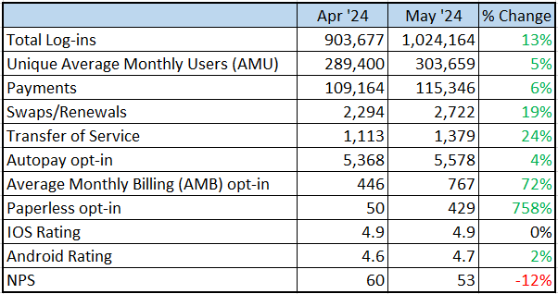
Reliant App | Stats

Slide 13
2024 DevOps Progress

Slide 14
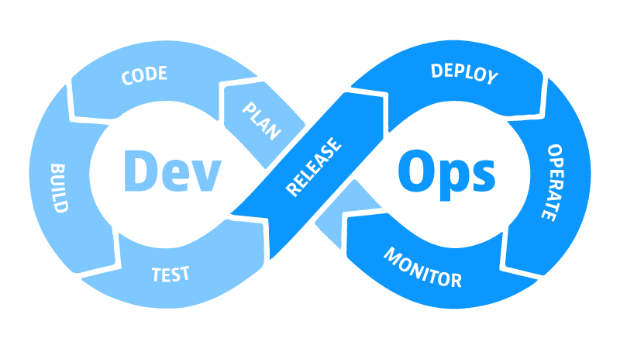
2024 DevOps Goals
Goal 1: Sonar Cloud Setup (integration and scan completed)
DevOps Area: Security
Current Status:
In Progress
Last analysisAug 28, 2024 45kLines of Code
0 Security Vulnerabilities
Needs improvement: Quality
Next steps: Disposition and Address clean code attributes and software quality issues found in the scan with API and FE Dev teams.
Goal 2: Fix Broken iOS and Android Automation test scripts (60 Android & 62 iOS broken scripts)
DevOps Area: Execution
Current Status:
In Progress
Android - All 60 were fixed
New pbi(s) raised for newly discovered broken scripts
iOS – All 62 were fixed
Goal 3: Test Automation Coverage Increase (Introduce Payment Flow coverage and add smoke test scripts to development pipeline)
DevOps Area: Execution
Current Status:
In Progress
2 scripts created for Payment Flow
Team anticipates 9 scripts needed

Slide 15
Most Notable Features of 2024

Slide 16
Reliant App Roadmap
Launches |  | Now (Next 2 sprints) | Next (Next 3 months) | Later
v8.6 (2/8/2024) (Defect Resolution) Design Related Defects (Digital Communication) Salesforce integration for Push Notification (Customer Experience) Reliant Rewind Wrap Up for 2023 v8.7 (3/13/2024) (Customer Experience) API Change to not allow customers to save invalid payment method (Customer Experience) Android - extend session timeout to 15 min (Defect Resolution) Seven (7) Analytics related fixes (Defect Resolution) Ten (10) Bug fixes v8.8 (4/25/2024) (Retention) Swap - CDP Early Touch (Retention) Add Paperless Tile (Customer Experience) Enhance Bill Menu (Customer Experience) Enhance Account Menu (Retention) 2024 Mass Offer – Flextra 2.0 (Retention) TOS - Make the "Outstanding Balance" threshold configurable and set it to $10K | v8.9 (7/31/2024) (Cross Serve) Demand Response – native enrollment and existing customer experience (Retention) TOS – implement Type Ahead for service address entry (Customer Experience) Allow customers with Non-Smart meter to use the app (Retention) Swap – add swap related alerts to Messages page (Increase App Users) App Sweepstakes – NFL jersey giveaway (Foundational) Upgrade of Android development libraries | v9.0 (ETA Early October) (Cross Serve) Protection Plans sign-up via web wrapper (Increase App Users) Define Universal Deep Links for Email/SMS (Customer Experience) Payment error messaging improvement (Retention) TOS - allow customers on AMB to transfer their service in app (Retention) RAF - display bill credits and points for customers on Loyalty Rewards program (Foundational) Implement System/Server Down Error Tracking across the app (Customer Experience) New journey for customers on General Motors EV plan (Customer Experience) Improve usage data experience fir customers on solar buyback (Customer Experience) Improve Bill Details view (Cross Serve) Remove Goal Zero | v9.1 (ETA Early December) (Cross Serve) Vivint – Essentials offer (Cost Reduction) Add Paperless option for disconnects (e-disconnect) (Cross Serve) Demand Response – Smart thermostat - Vivint (Customer Experience) Integration with ContentSquare for journey evaluation and recordings (Retention) Swap and Transfer of Service - Offer Card redesign (Customer Experience) Enable Face Id sign-in for Android (Solar) Improve Inverter experience (move from Enphase to Enode) | Billing/Payments​ Bill detail improvement - align with Reliant Bill Redesign Add ApplePay payment method​ Transfer of Service​ Offer to Swap plans​ if eligible Transfer to different TDSP in TX​ Cross-Serve​ (Cross Serve) Demand Response – DIY native enrollment Solar Buy Back – Native App Experience Cross Serve – Marketplace Cross-serve as part of Renewals Cross serve as part of TOS (Cross Serve) Demand Response – Smart thermostat - Pre-enrolled device tracker - Participant page Usage Solar Usage - Inverter Expansion Customer Experience Spanish language preference selection and content display Optimize app to work with Apple IPad and Android Tablet (Customer Experience) Improve experience for customers disconnected for non-payment Digital Communications Promote push notifications opt-in

Slide 17
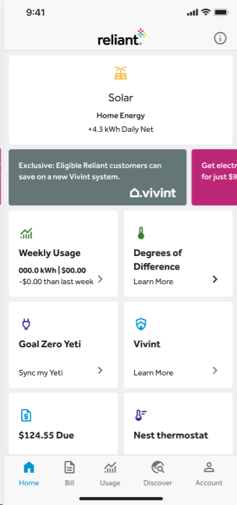
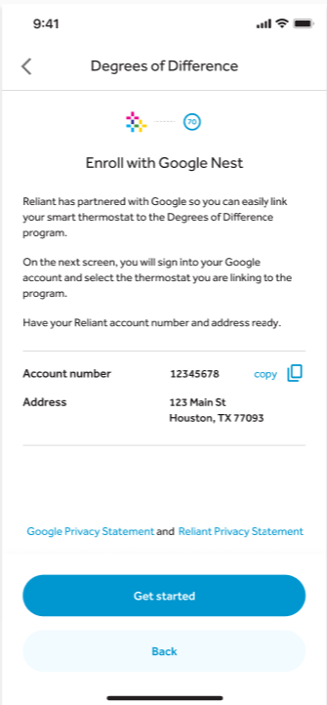
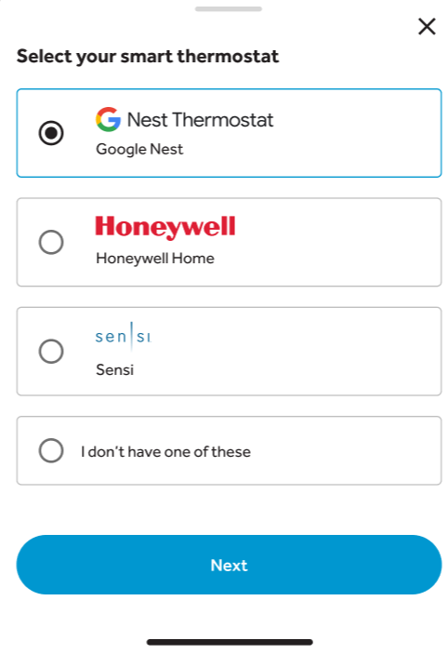
Reliant App | Implement App Native Demand Response Experience
(v8.9 launched 8/1/2024)
PROBLEM / NEED
Demand Response
Increase customer participation in Degrees of Difference (Demand Response) Program
Dashboard
Sign-up
SOLUTION
Thermostat Selection
Capabilities
Promote the program across multiple pages, including Dashboard, Discover tab, Bill Pay Confirmation Page, Account Menu Page, and Usage page
Sign up journey for Smart Thermostat program
Existing customer experience for customers on Smart program
BENEFITS
Helps reduce demand during peak usage
Environmentally friendly in reducing the need to build new peaking plants

Slide 18
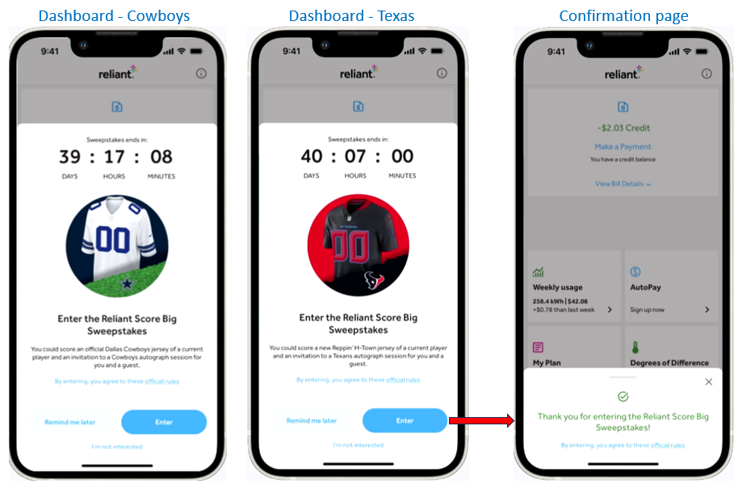
Reliant App | Sweepstakes – NFL Jersey giveaway - MVP
(v8.9 ETA July ’24)
PROBLEM/NEED
Run an NFL jersey give-away sweepstakes to entice customers to download and use the app
SOLUTION
Promo runs July 24th to August 24th
Giveaway 1 Texans and 1 Cowboys jersey depending on service area
To qualify, customers need to opt-in within the app
Promotional modal shown on log-in
BENEFITS
Help increase app Average Monthly Users (AMU)

Slide 19
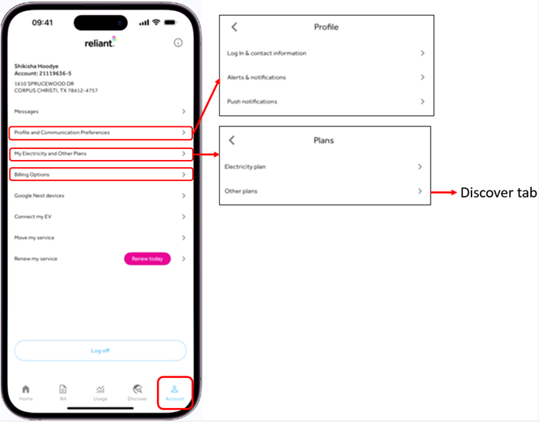
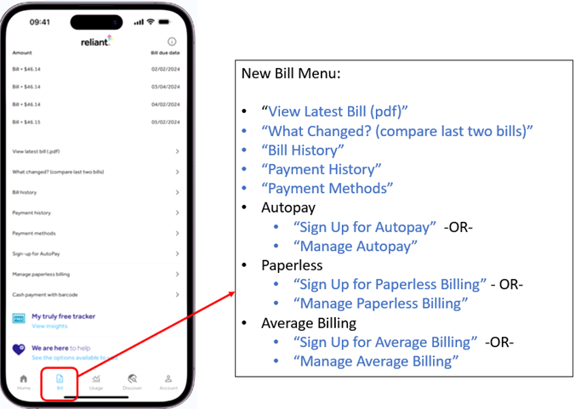
Reliant App | Improve Bill and Account menus
(v8.8 launched 4/25/2024)
PROBLEM / NEED
Improve Bill and Account menus to make it easier for customers to find key app features.
New Virtual Key
Install
Virtual Key
Confirmation
SOLUTION
Capabilities
Updated menu text to make it easier to understand
Reordered menu items
Implemented “Smart” menu text
BENEFITS
Improve customer experience

Slide 20
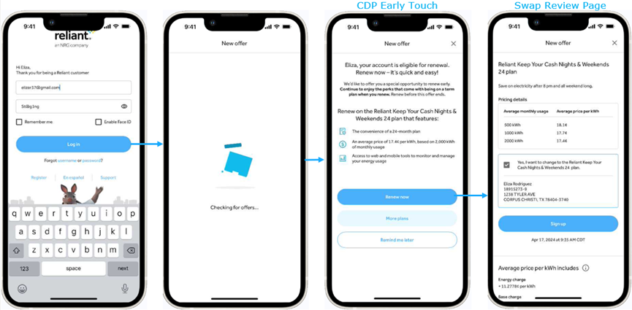
Reliant App | CDP Early Touch
(v8.8 launched 4/25/2024)
PROBLEM / NEED
Leverage CDP model to implement personalized experience for customer eligible for Early Touch swap type.
New Tesla/Smartcar
Access
New Virtual Key
Install
Virtual Key
Confirmation
SOLUTION
Capabilities
Display CDP Early Touch promotional page on initial log-in
Customer can proceed directly to Review page
-or- can view all available Early Touch offers
Once customer select an offer, the rest of the journey is identical to regular Swap sign-up flow
Improved previous CDP case (TFN) to utilize a different API parameter. This will make it easier to implement future CDP cases
BENEFITS
Increase conversion
Target audience: 25K customers per month

Slide 21
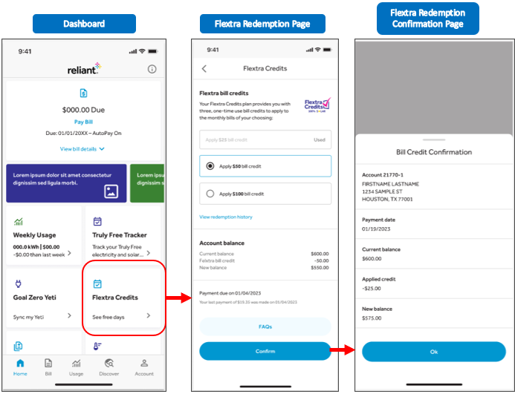
Reliant App | 2024 Mass Offer – Flextra Credits 2.0
(v8.8 launched 4/25/2024)
PROBLEM / NEED
Improve current Flextra Credits program to add flexibility
New Tesla/Smartcar
Access
New Virtual Key
Install
Virtual Key
Confirmation
SOLUTION
Capabilities
Ability to offer different credit amounts
Ability for customers to choose which available credit to redeem
API enhancement to automatically determine which credits were already redeemed, to minimize front-end work
BENEFITS
Increase conversion
Improve customer experience

Slide 22
Q&A – Open Discussion

Slide 23
Product Owner Perspective – Impediments
Impediment | Impact to the Team | Attempted Solutions | ASK from Leadership
Stage Environment - Annual Data refresh wipes out test accounts | Delays dev and testing | None Next: Need to automate the account reset | No ask from Leadership Raising for Awareness
Stage Environment - Availability (Resolved) | Delayed dev and testing during first 4 months of this year | Improvements made | No ask from Leadership Raising for Awareness
Stage Environment – Takes a lot of effort to set-up test accounts. Not all scenarios are available in lower | Delays dev and testing | Attempt to preset the accounts before UAT starts Next: Need to automate the scenario creation | No ask from Leadership Raising for Awareness
Technical Subject Matter Expertise - Capacity | Issue with securing prod. Accounts for testing and troubleshooting Ability to resolve prod. Performance issue (dashboards loading between 20-40 seconds Prod. Environment Stability | None (Accounts for testing) Slow load (Performance Issue) Non-commodity service improvements (Environment Stability) | Provide incentives to employees to become “friendlies” across brands – e.g. 40% energy discount And/or – easier shadow access for customer accounts Need a holistic review of services, APIs, and front end Need a holistic review of services, APIs to identify improvement opportunities. More proactive monitoring.
Old slide
Notes:
Production Environment – Need Prod accounts for testing and troubleshooting purposes - Delays dev and testing
Production Environment – Performance / response time - Response time between 20 to 40 seconds. Dashboard is most used.
Production Environment – Availability - Affects log-in, payments, non-commodity calls, etc. Individual servers bring down the front end
Intent – As a Product Owner – what are the top 3 impediments you face
WHAT is the Impediment
WHAT’s the Impact to the Team (why is this an Impediment)
What has the PO & Team tried to address the Impediment
What is the ASK from Leadership (if any) to help resolve the Impediment

